Slide 1

Grade 1
Letters Y & Z
April 10th , 2026
PREPARED BY: Mohamed Ali

Slide 2
1 min
Please ensure your device and internet connection are working properly before the session begins. In case of any technical issues during the session, please contact the branch leaders immediately.
1
2
Slide timings are flexible. You may move to the next slide if the content is completed before the assigned time.
General Instructions
3
Encourage students to participate by repeating words and sentences aloud and using their microphones when appropriate.
Use interactive tools such as the chat box and reactions to keep students engaged throughout the lesson.
4

Slide 3
Lesson Objectives
To learn the phonics of the letter ”Y”.
To learn the right way to write the letter “Y”.
To learn the phonics of the letter ”Z”.
To learn the right way to write the letter “Z”.
To learn using “ is this” ,” are these”.
1 min

Slide 4
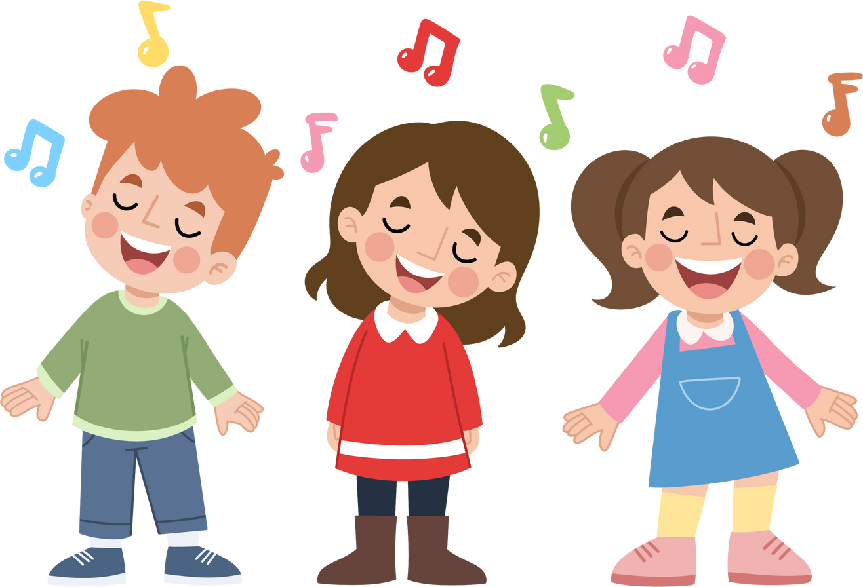
Sing along with the students during the following song & be interactive!

Slide 5
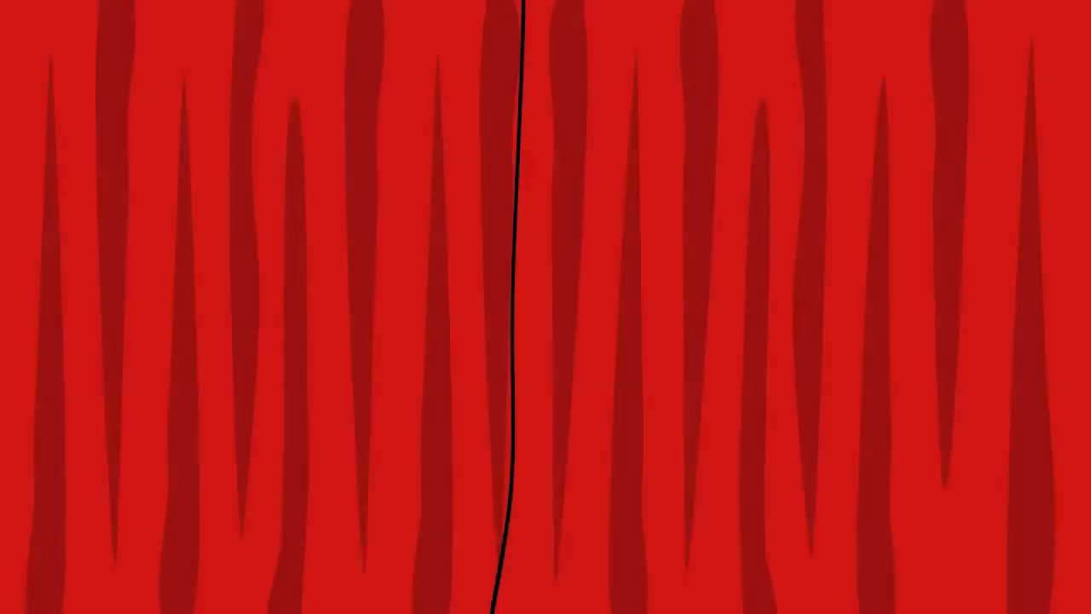
2:10 min
PLEASE AND THANK YOU!

Slide 6
Do you know this letter?

Slide 7
Please ask your students to draw the letter “Y y” in the air during the next video.

Slide 8
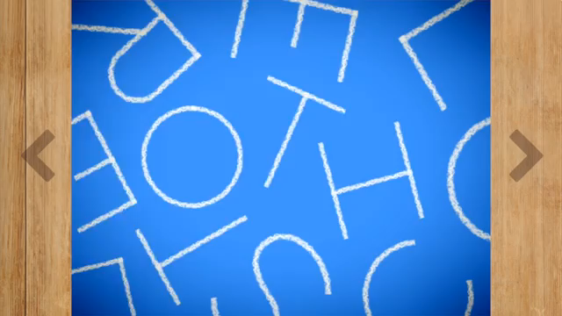
2:30 min
WRITING THE LETTER "Y"

Slide 9
2 min
Ask your students to write down the uppercase & lowercase of the letter “Yy” on their boards!

Slide 10

Memorize the following things that start with the letter “Yy”.
(3 min)
1- You
2 - Yes
3- Yellow
4- Yoyo

Slide 11
Memorize the following things that start with the letter “Yy”.
(3 min)
5- Yacht
6- Yarn
7- Yogurt
8- Yawn

Slide 12
Name the pictures:-
(3 min)
1
2
3
4
5
6
7
8

Slide 13
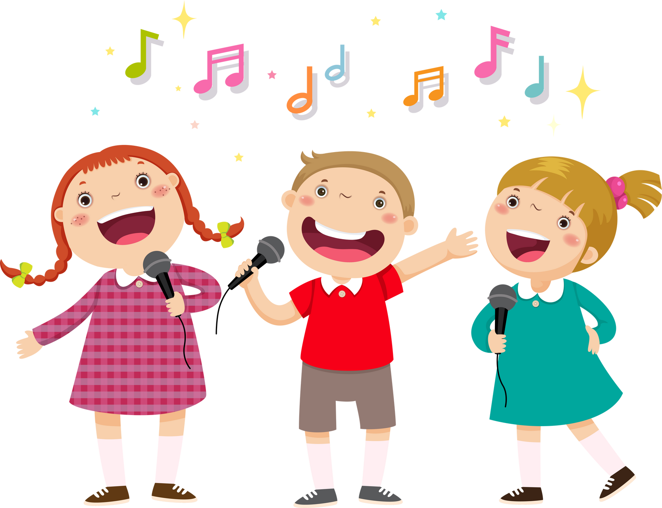
Please sing along with the students during the following song & be interactive!

Slide 14
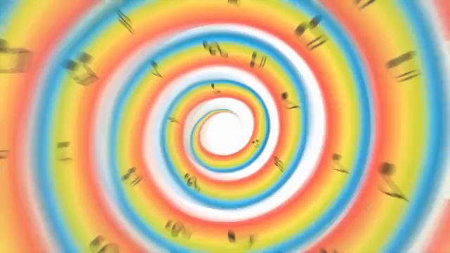
4 min
THE LETTER ”Y” SONG

Slide 15
Do you know this letter?

Slide 16
Please ask your students to draw the letter “Z z” in the air during the next video.

Slide 17
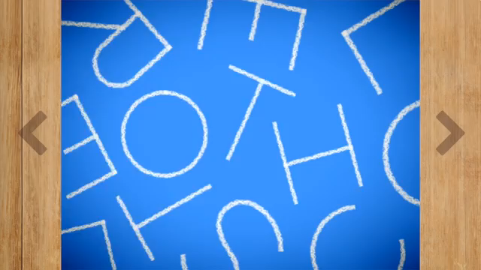
3 min
WRITING THE LETTER "Z"

Slide 18
2 min
Ask your students to write down the uppercase & lowercase of the letter “Zz” on their boards!

Slide 19
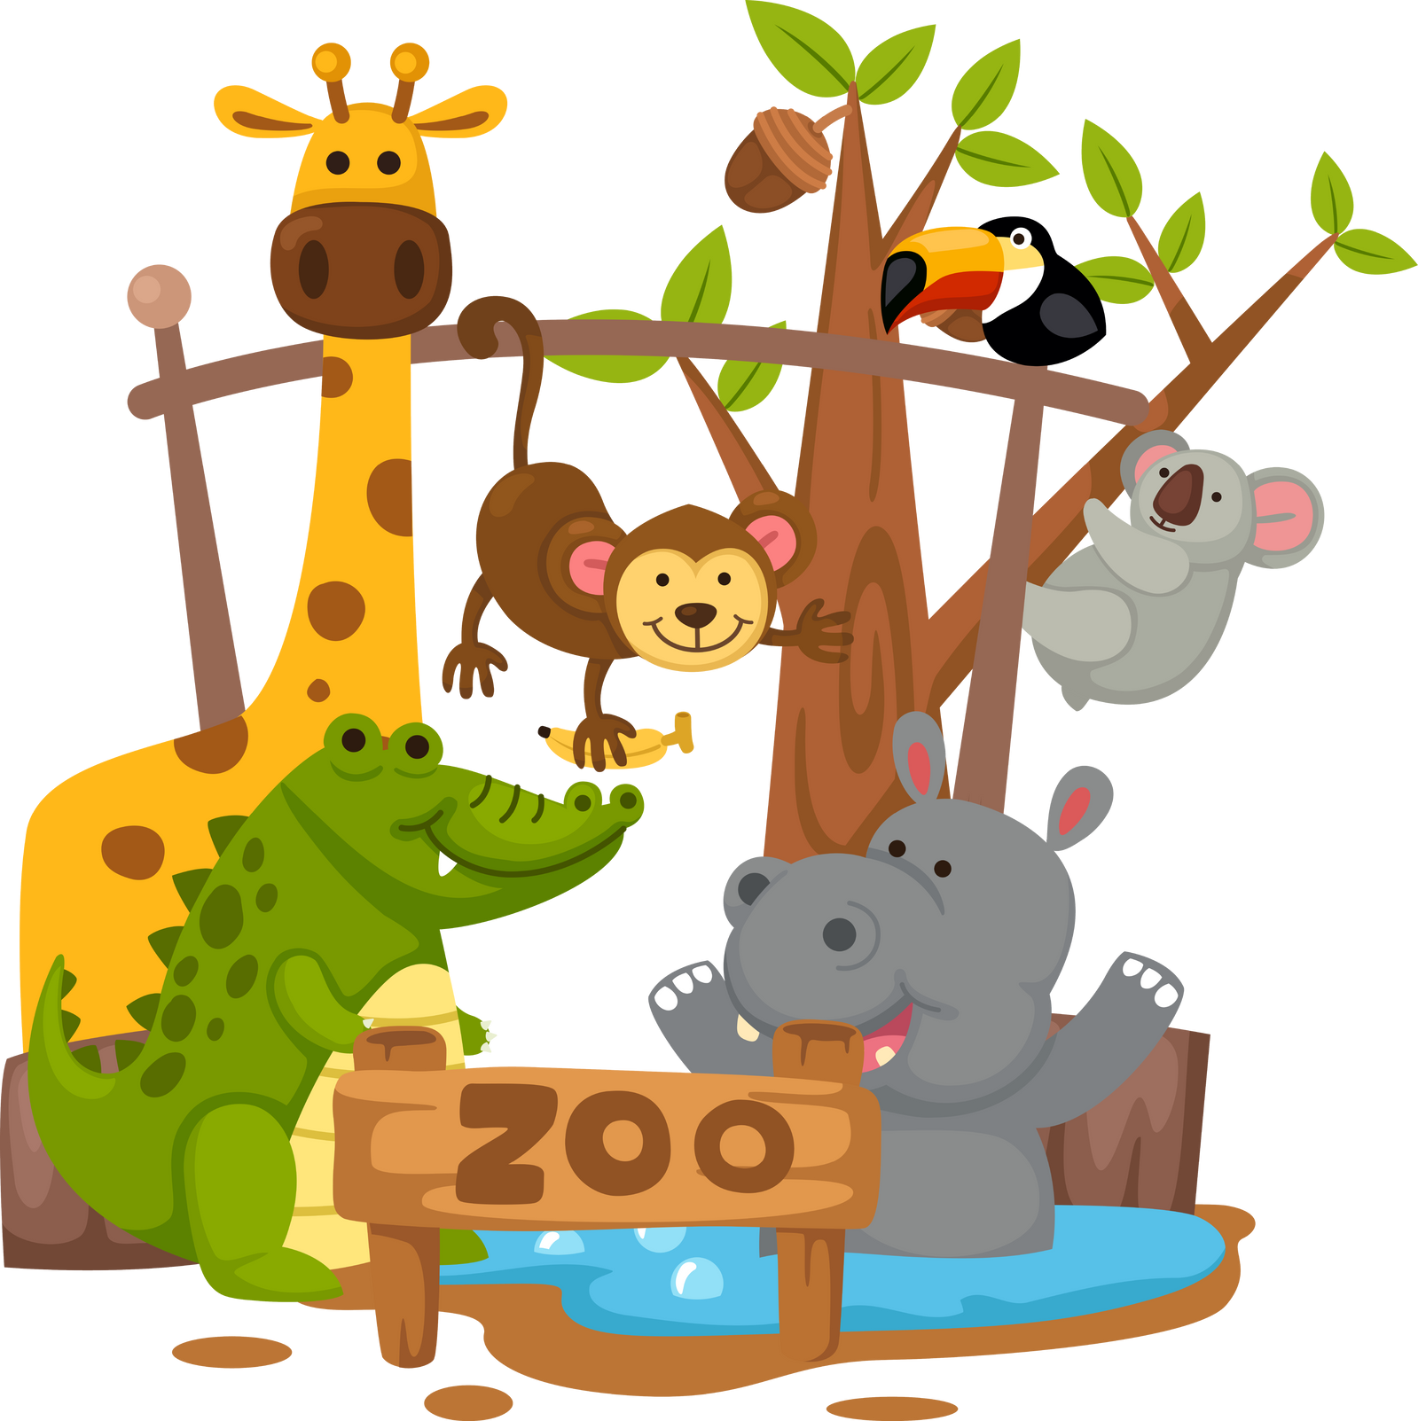

Memorize the following things that start with the letter “Zz”.
(3 min)
1- Zebra
2 - Zoo
3- Zero
4- Zigzag

Slide 20
Please sing along with the students during the following song & be interactive!

Slide 21

4 min
THE LETTER ”Z” SONG

Slide 22





2 mins
Is this…?
Is this your book?
Yes, it is. This is my book.

Slide 23

2 mins
Are these…?
Are these your books?
Yes, they are. These are my books.

Slide 24


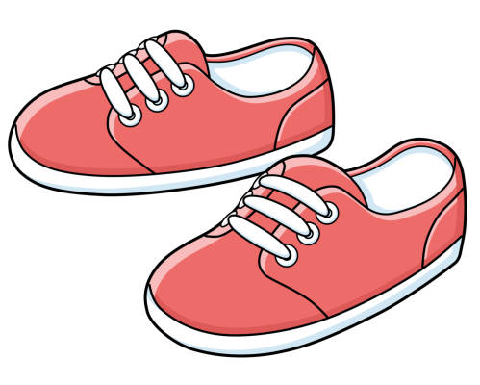

3 mins
Answer the questions
Are these your socks?
Is this your apple?
Are these your shoes?
Is this your hat?

Slide 25
Thank You!

